Slide 1
Malaria Detection
A Deep Learning Solution
Rohan Sudhir

Slide 2
TABLE OF CONTENTS
01
02
03
The problem
Proposed solution
Recommendations and Challenges

Slide 3
The Problem
01

Slide 4
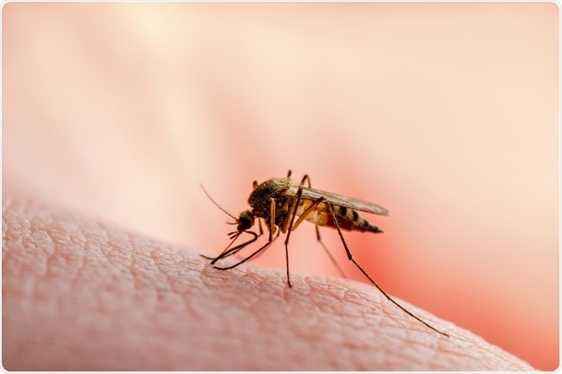
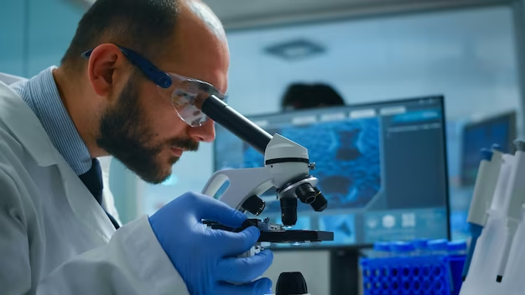
Malaria is a widespread, fatal yet preventable and treatable disease. Early detection can save millions of lives.
Classic approach for diagnosis (blood films) is labor intensive, time consuming and requires expert knowledge.
In need of a robust, reliable, and rapid solution for early detection.

Slide 5
02
Proposed Solution

Slide 6
Main Aims
Identify the distinctive features separating infected and uninfected cells.
Develop a Machine Learning model that accurately classifies images of cells.
Ensure that the model responds well to unseen data.
Minimize misclassification instances of infected cells being labelled healthy.

Slide 7
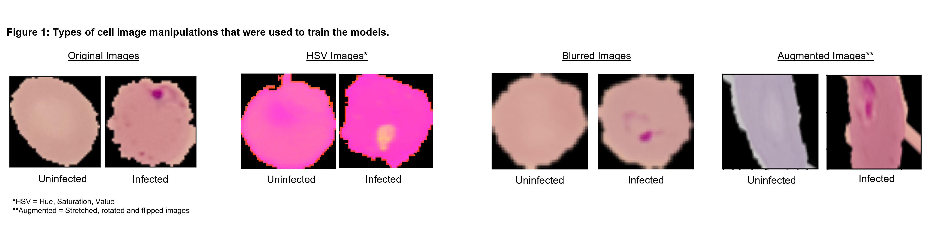
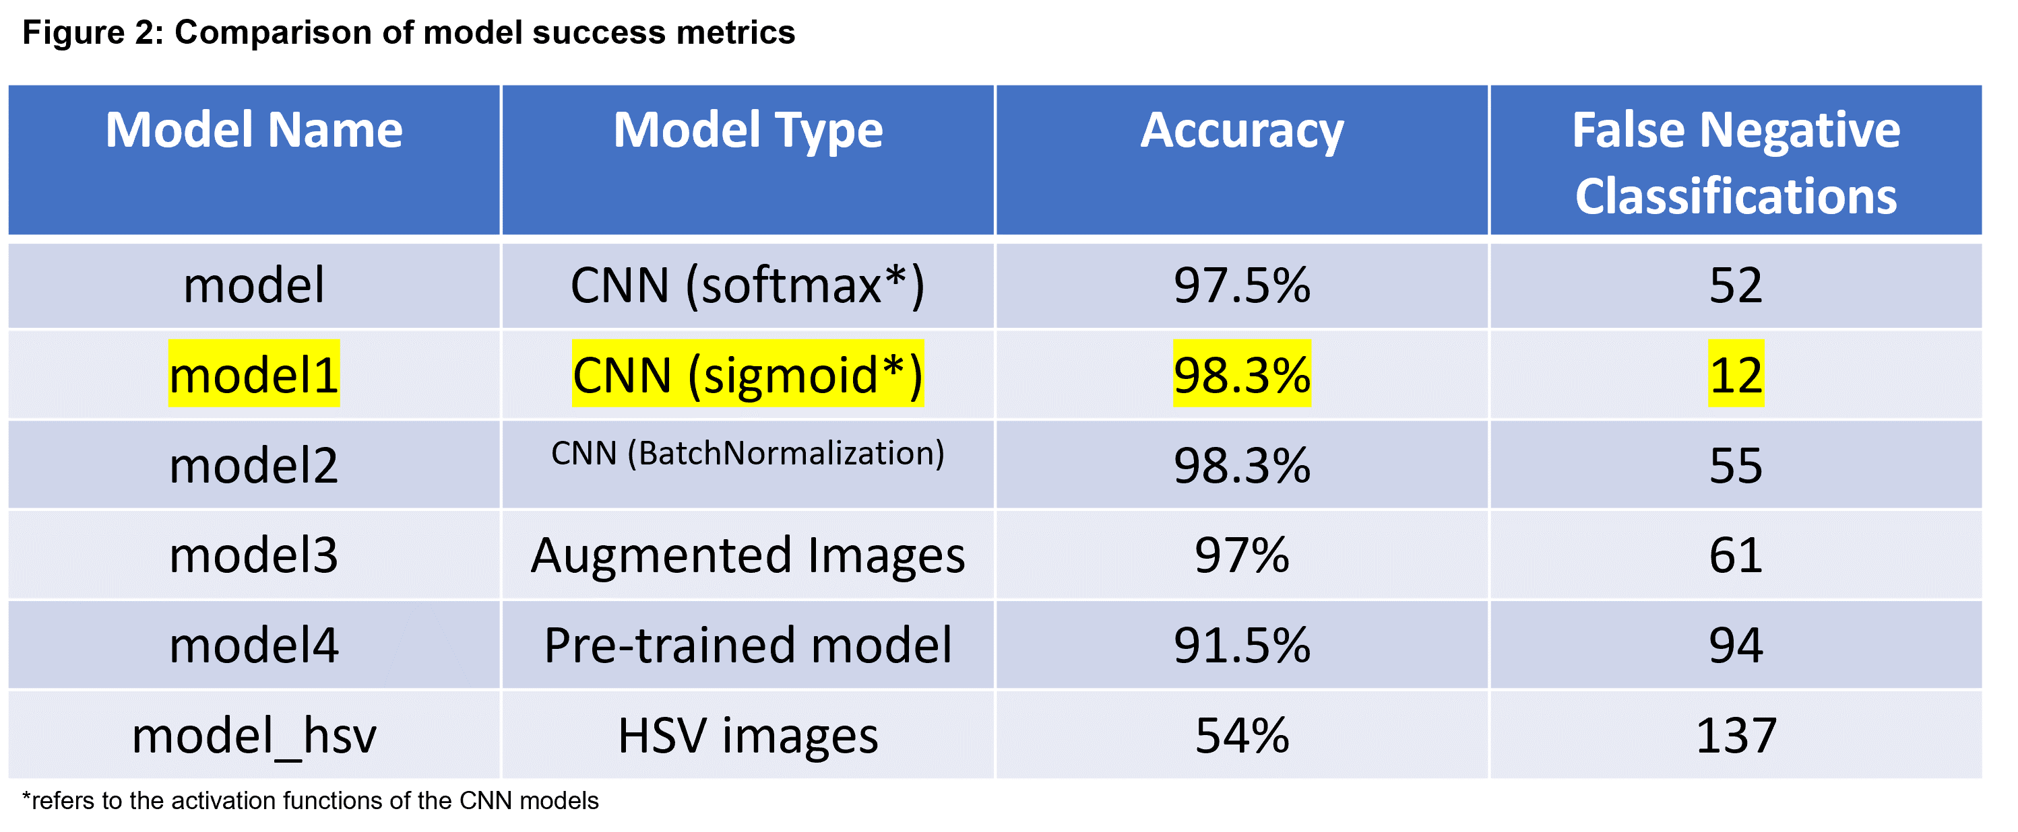
Exploration
1. Visualized the cell images – notice the purple discoloration.
2. Convolutional Neural Network (CNN) models are a standard approach for an image classification problem.
3. Developed 6 CNN models using different parameters, pre-trained models and varied image inputs.

Slide 8
Final solution
‘model1’
A CNN model with a 98.3% accuracy.
Only 12 instances of misclassifying infected cells as healthy, from a test dataset of 2600 images.
Treats the problem as a binary classification problem (1 for infected, 0 for healthy).
Uses the original images as the data input which maintains all details of the cells and simplifies the data collection process.

Slide 9
Recommendations and Challenges
03

Slide 10
INFRASTRUCTURE
DATA COLLECTION
INTEGRATION
USER TRAINING
Implementation
Host the model on cloud – scalable + cost effective (AWS*)
New image data can improve the model performance over time
Add to existing healthcare information systems for seamless distribution
Teach healthcare professionals how to use the tool for easier adoption
*around $10,000 annually per 100,000,000 predictions ($0.10 per 1000 predictions according to Amazon ML quotes)

Slide 11
Challenges
Mishandling sensitive information can leave patients vulnerable and cause legal repercussions for businesses.
Cloud solutions are not viable in low resource, low connectivity areas. Local solutions are needed.
Data Quality
Future
proofing
Data Privacy
Low-resource locations
Model performance is highly dependent on quality of microscopic images.
Expand to multiclassification. Explore specialized pre-trained models.

Slide 12
THANK YOU

Slide 13
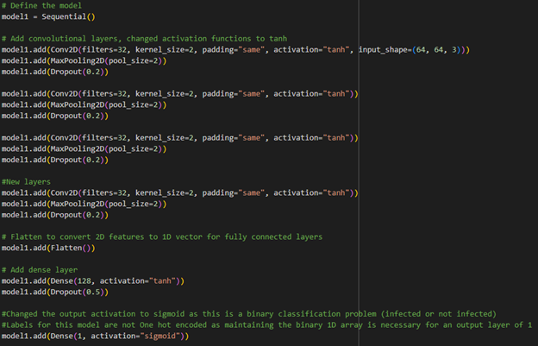
APPENDIX
Proposed solution code:

